Slide 1

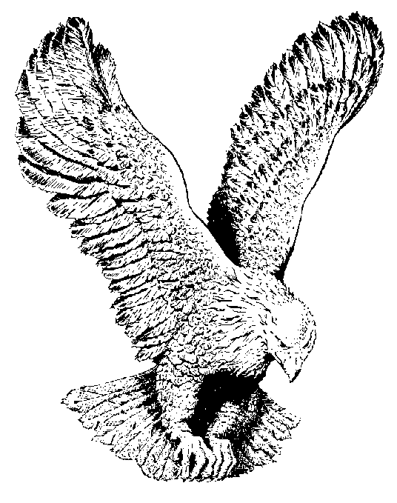
OMNIPOTENT GOD
Omnipotent God, I worship you,
Your majesty;
Is forevermore!

